Slide 1
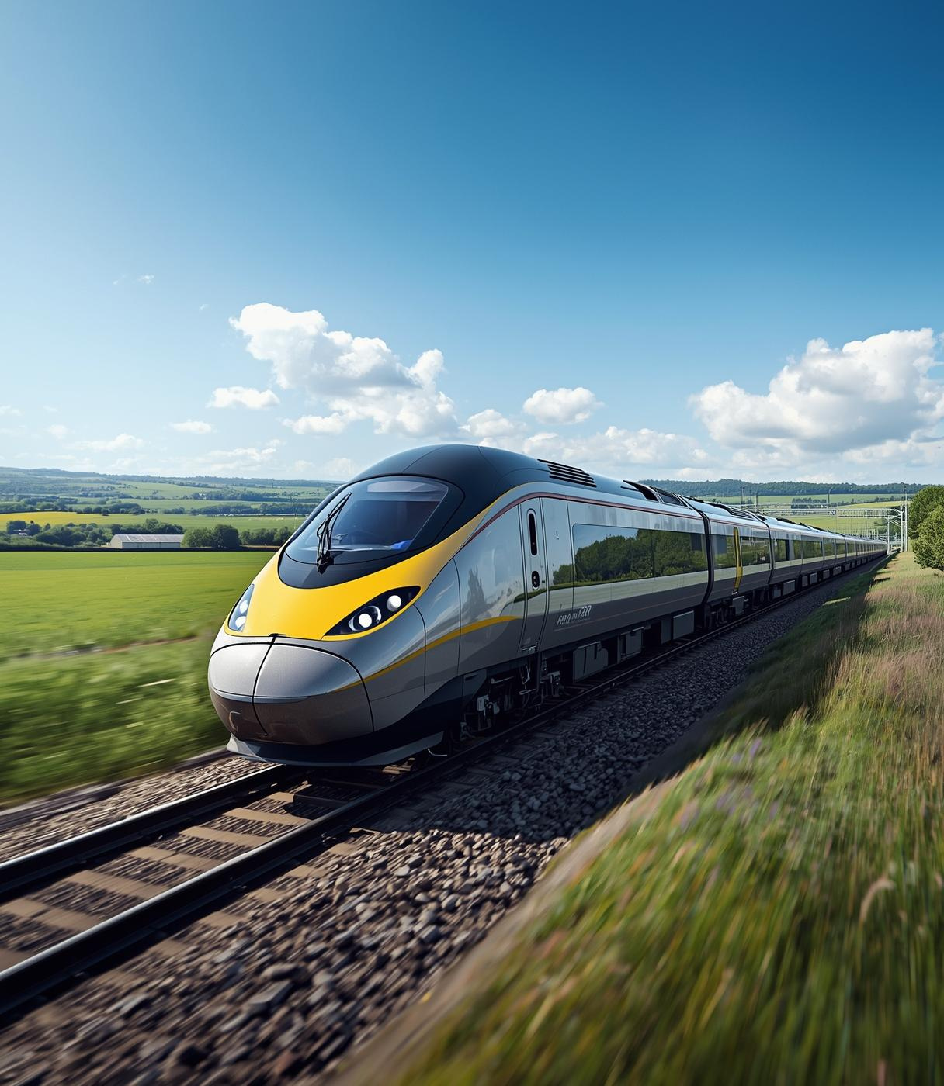
UK Trains
Performance Dashboard
Team Presentation Overview
PRESENTED BY
Ninja Turtles Team

Slide 2
Agenda:
Meet the Team
What Is Our Project?
Why This Topic Matters?
Data Preparation
Performance Overview
Customer Profile Analysis
Financial Impact
Performance Analysis
Customer Satisfaction
Insights & Recommendations
Key Insights from Analysis
Strategic Recommendations
11.Conclusion

Slide 3





Meet the Team
RANDA ABU ELMAGD
KIROLLOS ADEL
AHMED RADY
MAYA MOHAMED
MALAK EZZAT
Data Cleaning
, Modeling
,Customers
& Financial
LinkedIn:
Randa Abu Elmagd
Presentation
, Documentation
&Overview
LinkedIn:
Kiro Adel
Performance
& Satisfaction
LinkedIn:
Ahmed Rady
Insights & Recommendation
LinkedIn:
Malak Ezzat
Customers &
Financial
LinkedIn:
Maya Mohamed

Slide 4
What Is Our Project?
Our project focuses on analyzing UK train performance, customer profiles, financial impact, and satisfaction through an innovative Power BI dashboard designed to enhance customer experience.

Slide 5
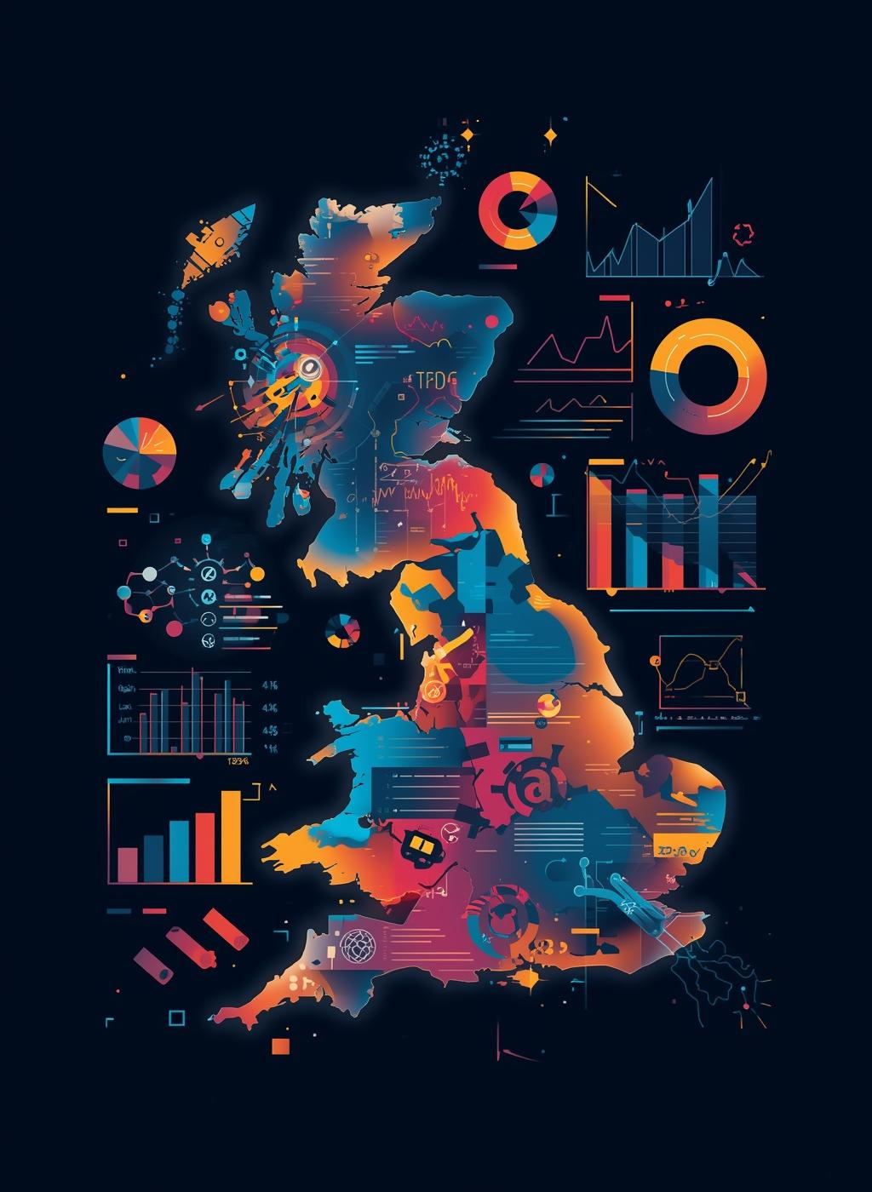
Why This Topic Matters?
Our project explores critical aspects of UK train performance, focusing on operations, customer satisfaction, financial impacts, and user experience to enhance overall service quality.

Slide 6
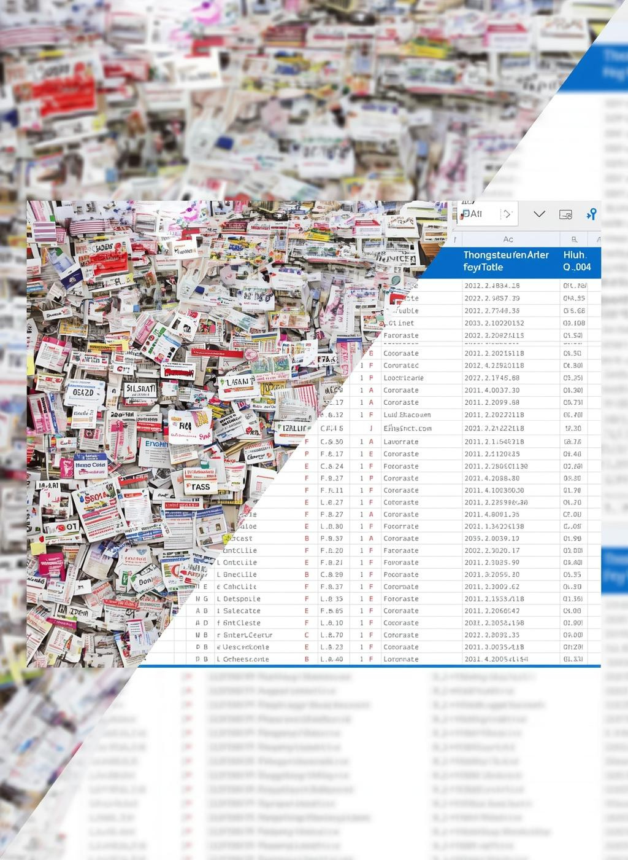
Preparing the Data
In this phase, we meticulously cleaned and structured our dataset to ensure accuracy, removing duplicates and correcting inconsistencies for reliable analysis and insights.

Slide 7
Data Preparation Steps
1. Excel Work
2. Power BI Work
Stations Table
Extracted the stations from the journey table.
Used Remove Duplicates
.Created an ID for each station.
Added the address for every station.
Trains Table
Removed duplicates.
Created an ID for each train.
Deleted any repeated or unnecessary columns.
Uploaded the cleaned file to Power BI.
Continued data cleaning and structuring
Dimension Tables Created
  (Station Dimension / Train Dimension / Schedule Dimension / Customer Dimension )
Ensured all dimension tables are clean and analysis-ready
Fact Table & Schema
Journey Fact Table
  Linked with dimension tables
  Foreign Keys set in the Journey Fact Table
  Primary Keys set in all dimension tables
Star Schema Structure
  Journey Fact Table at the center
  Dimensions surrounding it: Station, Train, Schedule, Customer

Slide 8
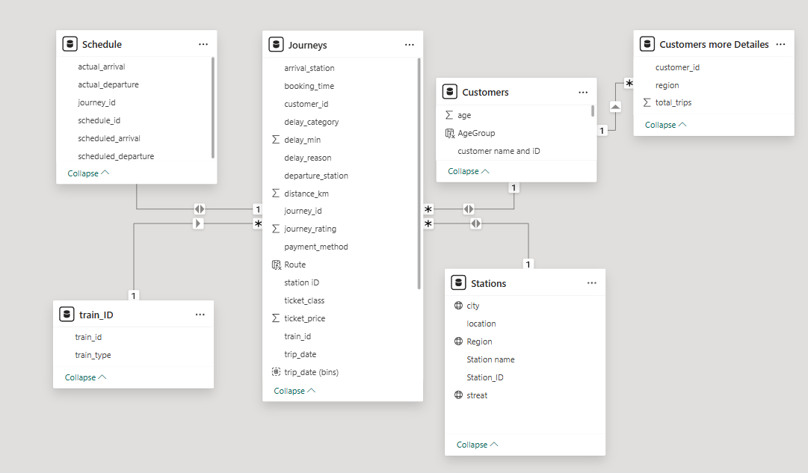
Data Model Overview
This section outlines the star schema architecture of our data model, focusing on key entities: Journeys, Customer, Stations, TrainID, and Schedule.

Slide 9
Our Storytelling Flow
This presentation outlines a cohesive narrative that guides our analysis, covering key areas from customer experiences to financial outcomes, helping us make informed recommendations.

Slide 10
Overview of Performance
"How is the railway system performing overall?"
This section presents key performance indicators, including total journeys, revenue, and average delay, offering insights into the efficiency of UK train services and customer experience.

Slide 11
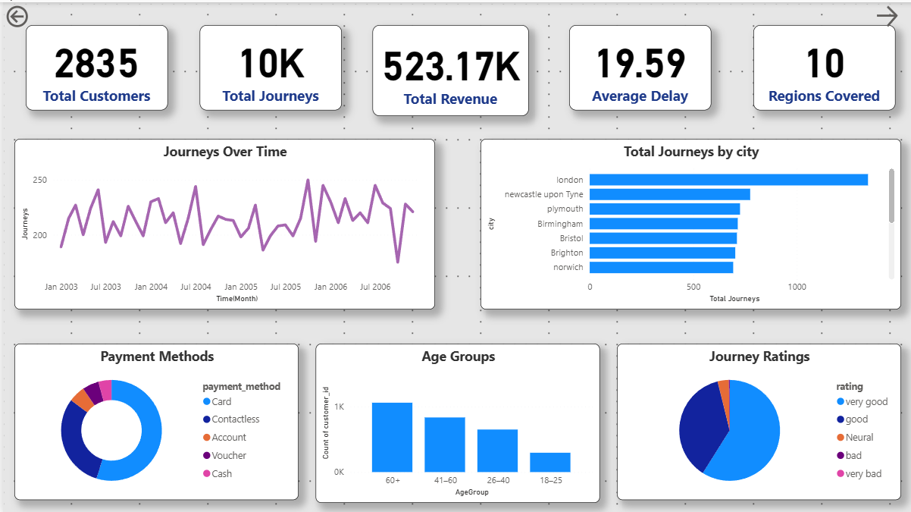

Slide 12
Customer Profile
How do customers interact with UK train rides?"
This section analyzes customer behavior, exploring key metrics such as total
customers, gender ratios, age distributions, trips per station, and ticket class usage to
inform strategic decisions.

Slide 13
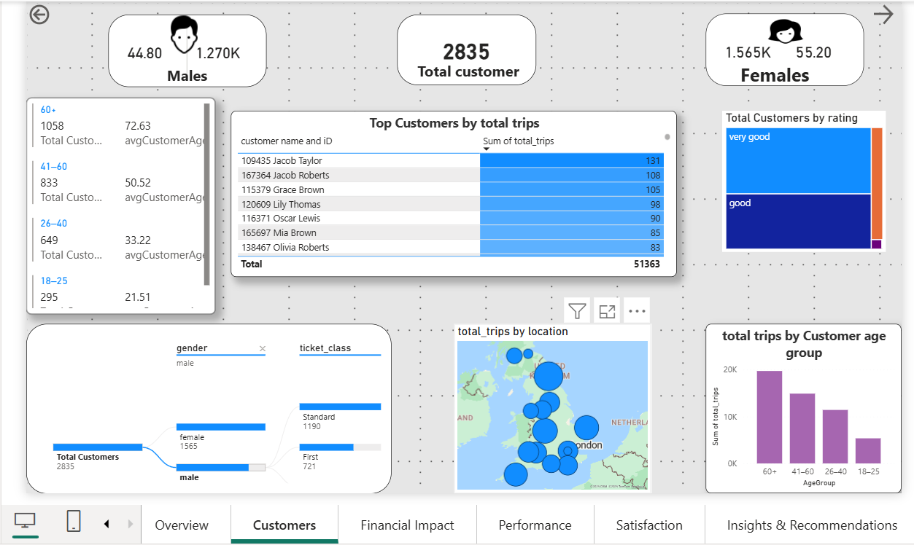

Slide 14
Financial Impact
"How do customers and ticket sales affect station
performance and revenue in the UK?"
This section analyzes ticket pricing and buyer behaviors, exploring revenue
patterns across cities and stations, and examining how payment methods
influence overall financial performance.

Slide 15
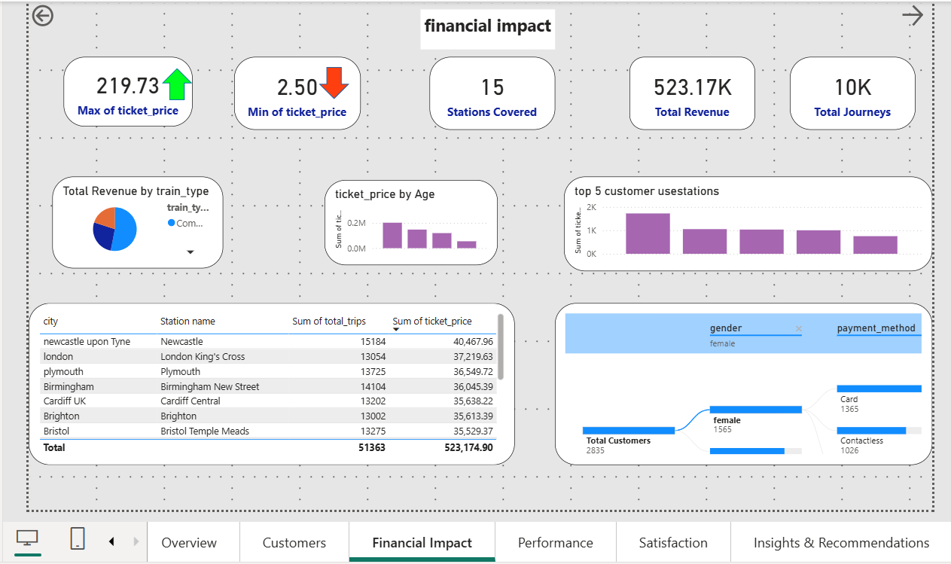

Slide 16
Performance Analysis
"How do journey volumes, ticket classes, and revenue distribution
across UK stations affect overall railway performance?"
This section delves into the performance metrics of UK trains, analyzing journey volumes by station, revenue generated by ticket class, and identifying top-performing stations to enhance operational efficiency.

Slide 17
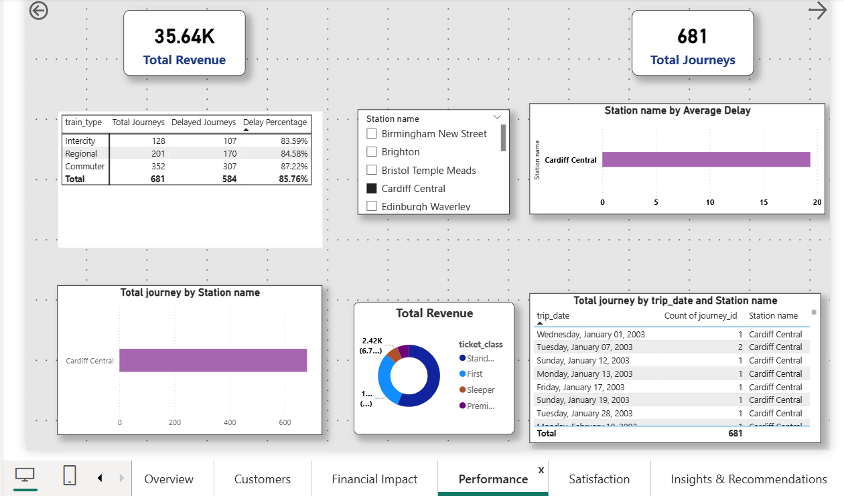

Slide 18
Customer Satisfaction
How do delay reasons, train types, and journey disruptions impact
customer satisfaction and ratings in the UK rail system?"
Understanding customer satisfaction is crucial for improving train services. This section
analyzes delayed journeys, common reasons for dissatisfaction, and ratings across
different train types.

Slide 19
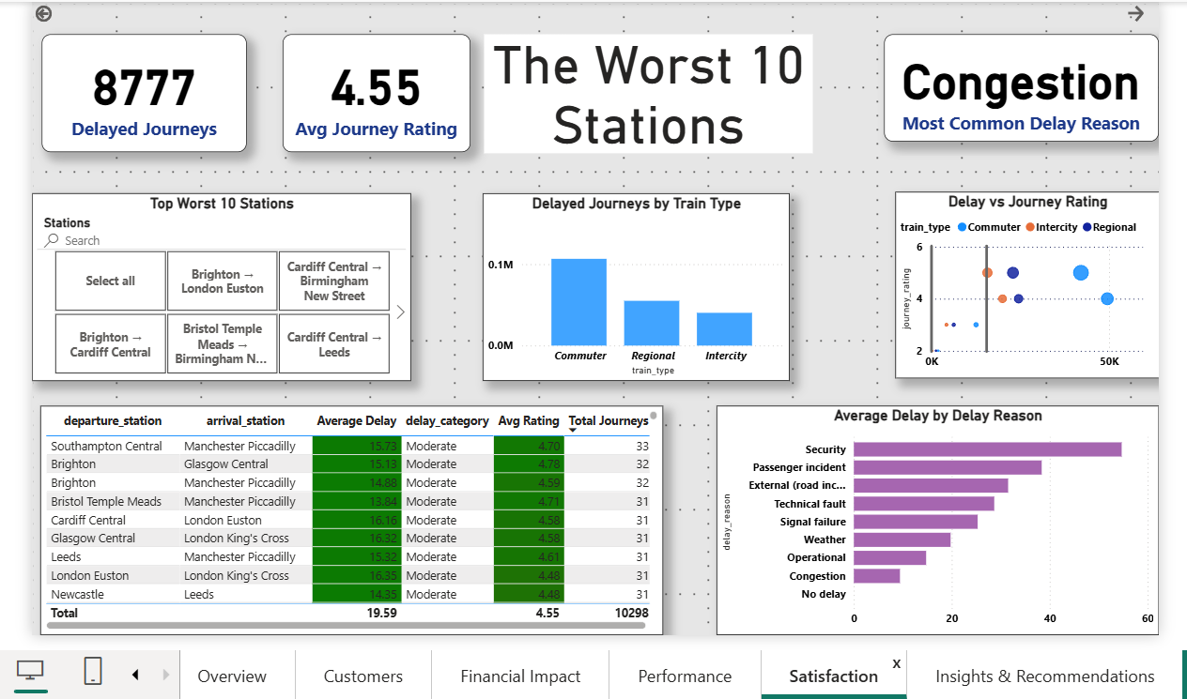

Slide 20
Insights & Recommendations
"What are the most important findings from the railway dataset, and what
strategic actions should the business take next?"

Slide 21
1. Key Insights from Analysis
Critical findings from customer data, journey performance, and demographic analysis
1. Customer Usage
The dataset shows 2,835 customers generating over 10,000 journeys. This indicates strong repeat behavior, with many customers taking multiple trips per year.
2. Revenue Performance
A total revenue of £523K generated from a relatively small customer base suggests high monetization per user, but also highlights limited market reach.
3. Operational Delays
The average delay is 19.59 minutes per journey, significantly above acceptable performance benchmarks and likely affecting journey reliability.

Slide 22
Additional findings on demand patterns and customer satisfaction
4. City Demand Variance
Journey volume is heavily concentrated in London, while other cities such as Norwich and Southampton show low activity, indicating uneven regional demand.
5. Passenger Demographics
The majority of passengers fall within the 40+ age group. Younger segments (18-25) are underrepresented, showing a demographic imbalance.
6. Customer Ratings
Despite high delays, most journeys are rated 4 or 5 stars, reflecting strong overall satisfaction.

Slide 23
2-Strategic Recommendations
Actionable strategies to improve efficiency, revenue, and customer satisfaction
Strengthen Customer Retention
Introduce loyalty rewards, travel passes, and targeted campaigns to maintain high repeat usage.
2. Increase Revenue per Customer
Offer premium add-ons such as WiFi, seat upgrades, and monthly commuter plans to grow revenue.
3. Reduce Delay Impact
Analyze delay-heavy routes, optimize schedules, and implement predictive maintenance to improve punctuality.

Slide 24
Continue building growth through expansion and targeted initiatives
4. Expand Regional Demand
Increase train frequency or run targeted promotions in underperforming cities to balance journey distribution.
5. Attract Younger Passengers
Introduce youth discounts, student passes, and social-media-driven campaigns to grow younger segments.
6. Leverage Strong Ratings
Promote high customer satisfaction in marketing materials and continue improving journey experience.

Slide 25
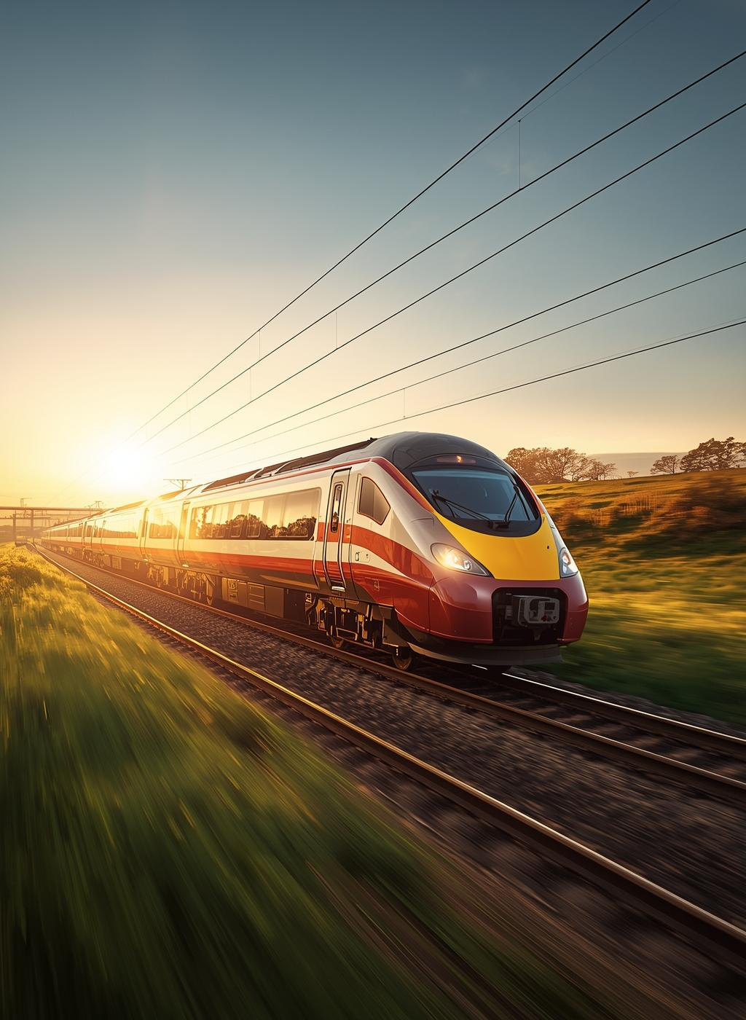
Conclusion
In summary, delays profoundly affect customer satisfaction, and enhancing train performance is crucial for improved ratings and increased revenue.

Slide 26
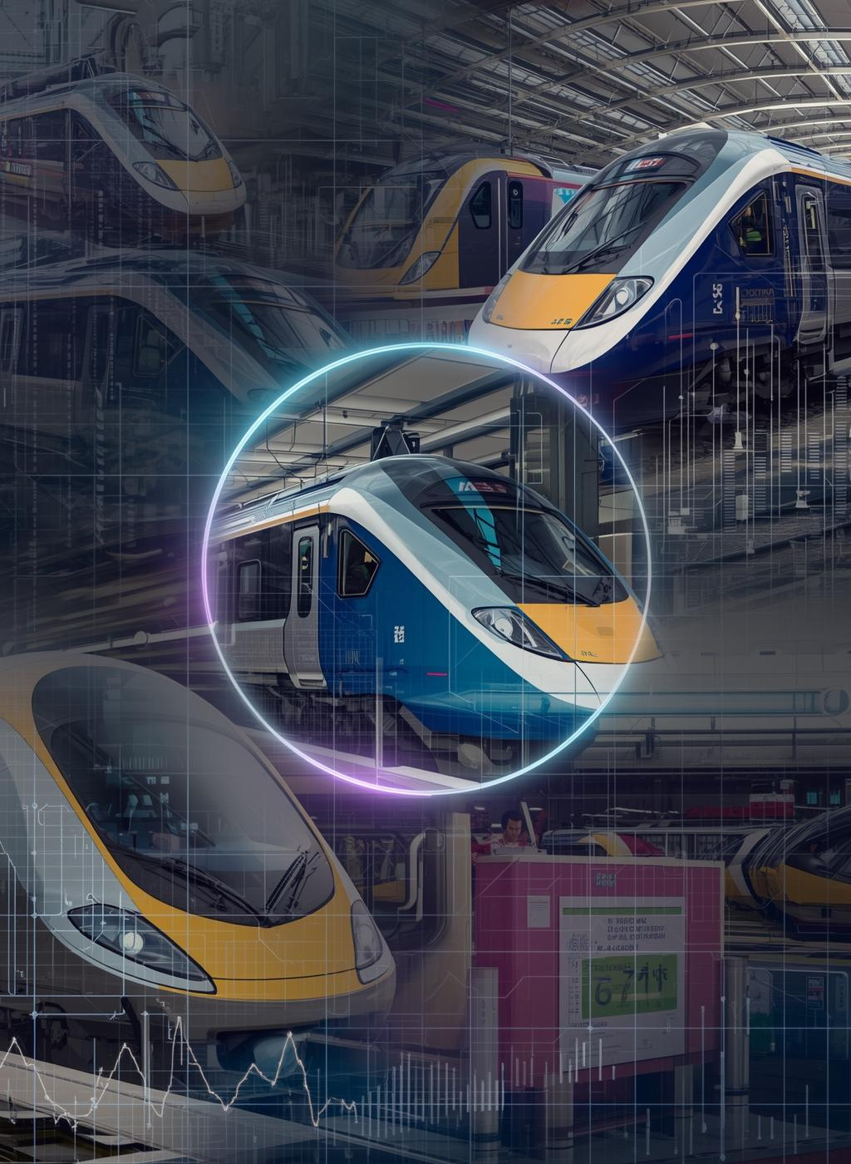
Thank You

